Slide 1
To-Do List
A to-do list serves as a single yet powerful organizational tool, enabling individuals to manage tasks, prioritize, activities and track progress effectively. It typically consists of a list of items or task to be completed, often categorized by urgency or type of activity.
TASK 3

Slide 2

Step-Wise Description
Task Collection:
Users jot down or input all the tasks, errands or activities they need too accomplish.
Categorization and Prioritization:
Task are often categorized or prioritized based on urgency, importance or specific categories.
Execution:
Users begin to work through the tasks on the list, marketing them as completed or in progress.
Monitoring Progress:
Tracking the progress of completed tasks and identifying any pending or overdue items.

Slide 3
Summary of your task
A to-do list is valuable tool that helps individuals organize tasks, activities and goals. It involves jotting down tasks, categorizing and prioritizing them , setting deadlines and regularly reviewing and adjusting the list.
By aiding in time management and task completion scheduling, it supports users in monitoring progress, reflecting on accomplishments, and reassessing pending tasks. This simple yet powerful method improves productivity, reduce stress and ensures important tasks are efficiently managed and completed.

Slide 4
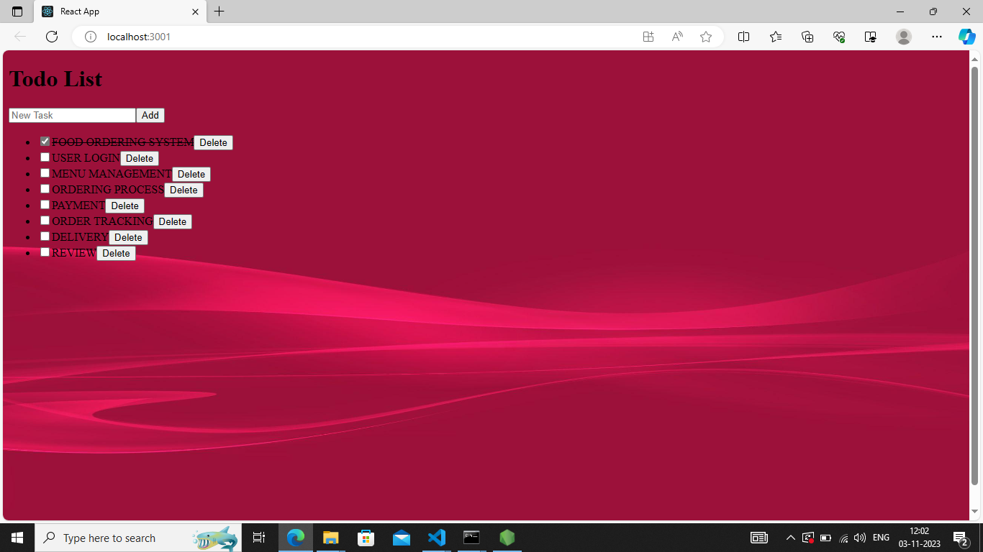

Slide 5
Submission Github
Insert Your Github Link Here

